Slide 1

Exploratory Data Analysis
Pink and Yellow Cab EDA and Recommendation
Richard M. Flores
November 21st, 2022

Slide 2

Agenda
Executive Summary
Problem Statement
Approach
EDA
EDA Summary
Recommendations

Slide 3
Executive Summary
In this Research Study, we will conduct an Exploratory Data Analysis and create a forecast model using the “Cab_Data” dataset to provide a recommendation to stakeholders on whether the Yellow Cab or Pink Cab company will provide the best return on investment.

Slide 4
Problem Summary
This Exploratory Data Analysis report will seek to find the best investment opportunity through statistical analysis of the provided datasets. In these datasets we will measure and compare metrics such as trip mileage, geolocation, transaction methods, and customer demographics.

Slide 5
Approach
The approach in this research study includes the following steps:
Data Cleaning via Tableau Prep
Detecting Missing, Null, and Outlier values
Measuring Central Tendency and Dispersion
Calculating Frequency, Skew, and Kurtosis
Creating visualizations through Histograms
Conducting Hypothesis Testing
Creating forecast models with Machine Learning

Slide 6
EDA
After completing the Data Cleaning process, we begin our Exploratory Data Analysis with data exploration and visualization tools found in Tableau.
The Tableau software allows us to join our datasets through unions using key ID’s and aggregate data to develop insights about the Yellow and Pink cab companies.

Slide 7
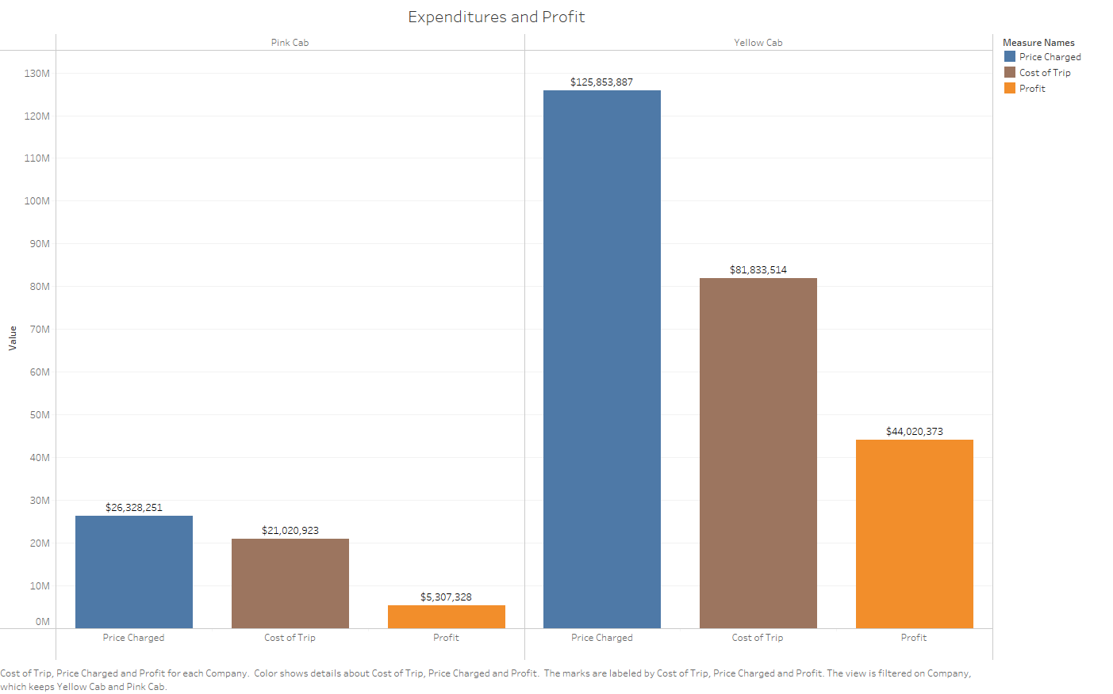

Slide 8
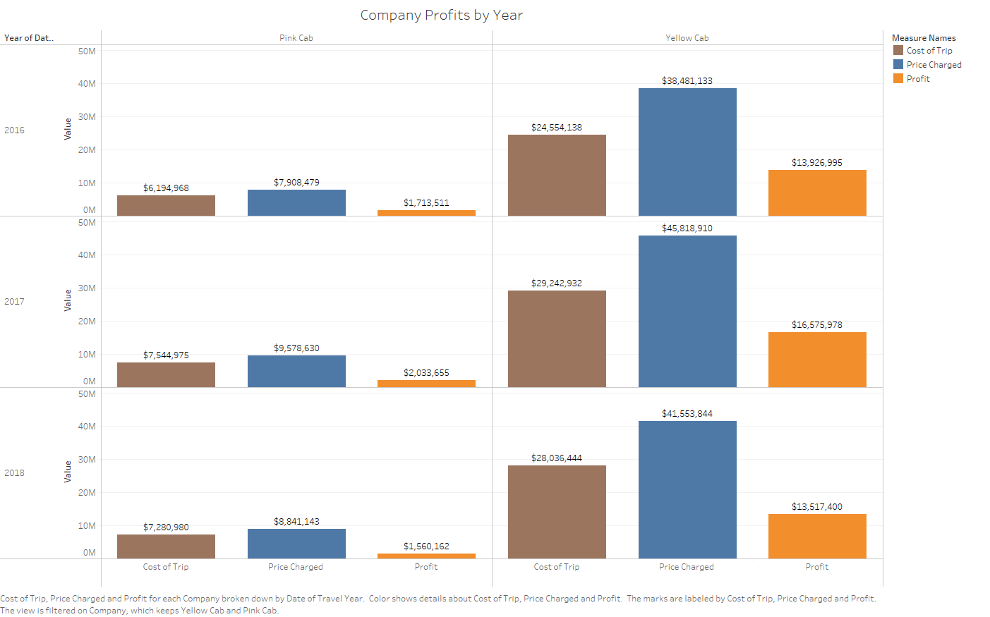

Slide 9
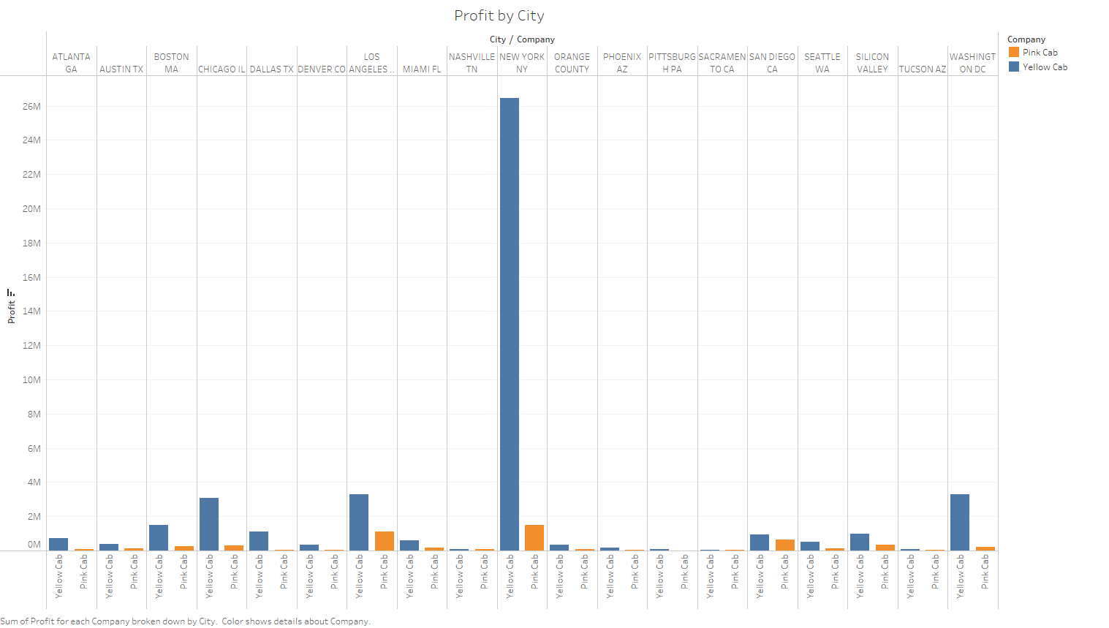

Slide 10
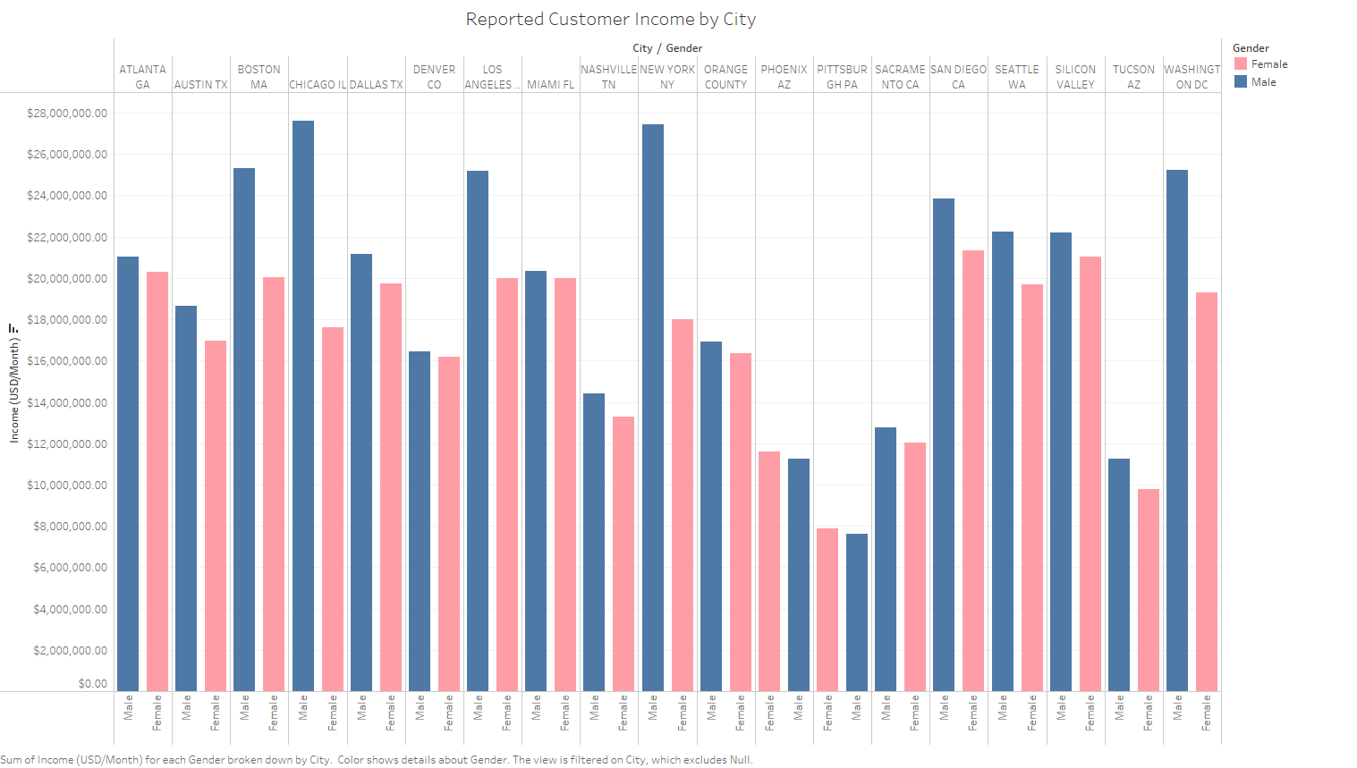

Slide 11
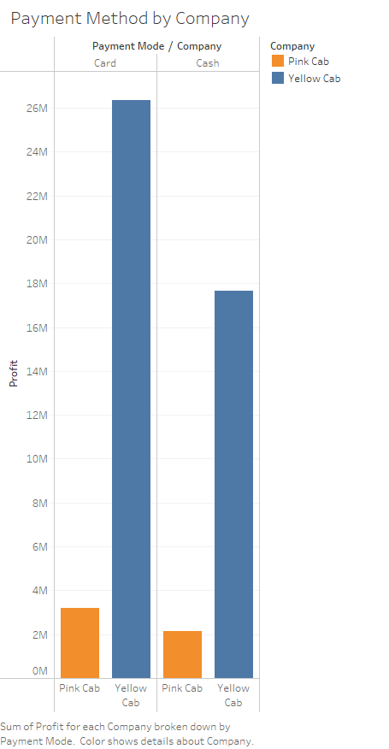
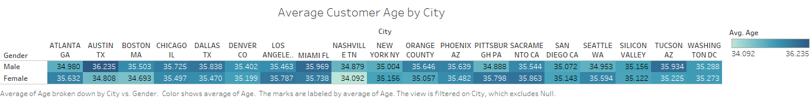

Slide 12
EDA Summary
A thorough and complete Exploratory Data Analysis contains essential visualizations for exploring and delivering metrics found in the data.
In our EDA we have included visualizations for detecting outliers using Boxplots, creating Frequency Bins to view the range of values available, and Univariate Distribution Plots to view modality in the features.
We conclude our EDA with Data Science models including Linear Regression Models to assist in forecasting logistics and profit and Hypothesis Testing to answer research questions.

Slide 13
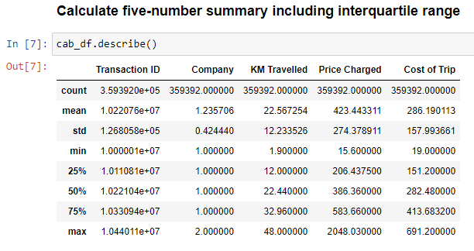
Calculating Measures of Variability and Disperion

Slide 14
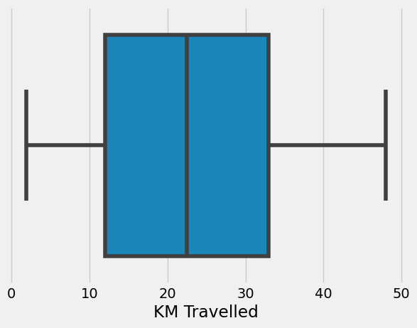
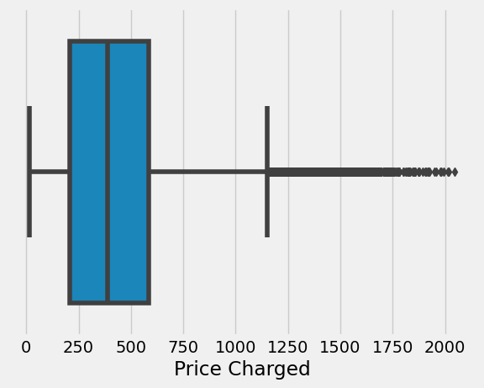
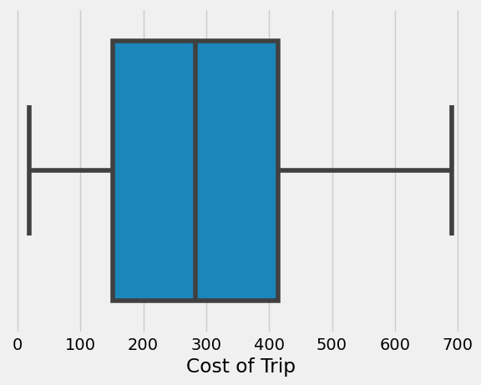
Detecting Outliers through Boxplots

Slide 15
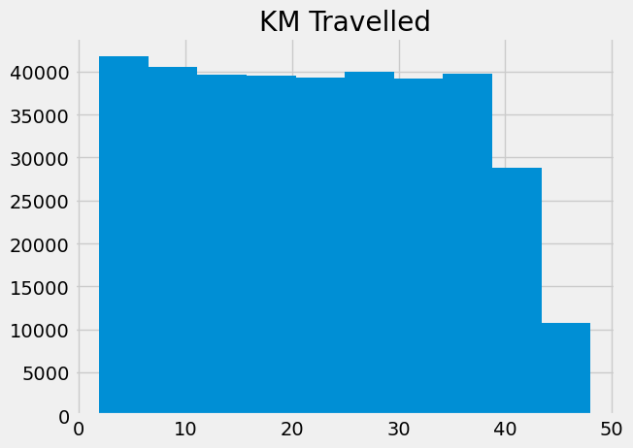
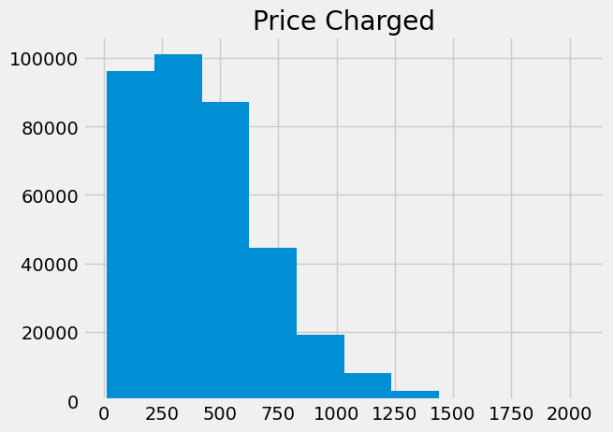
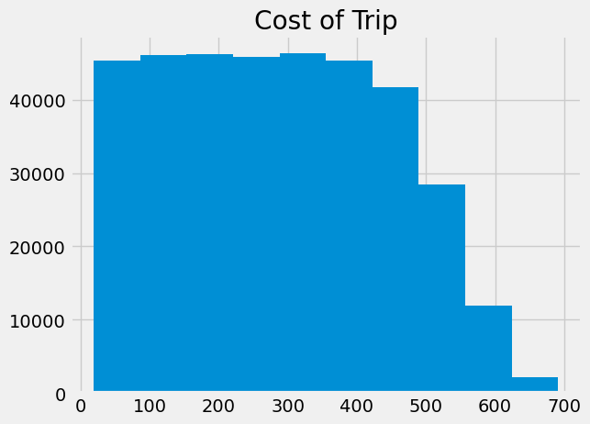
Visualizing Frequency Bins

Slide 16
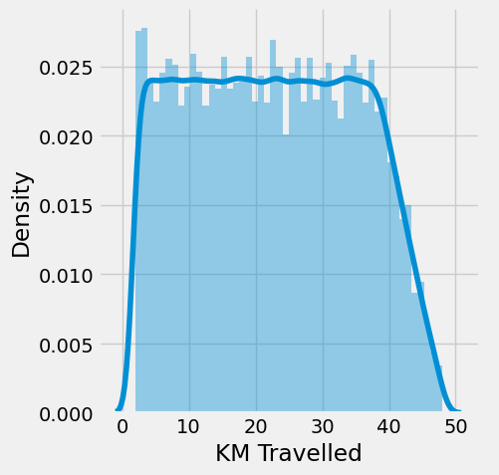
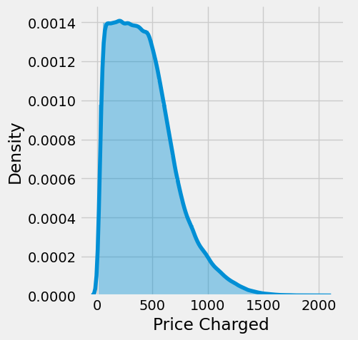
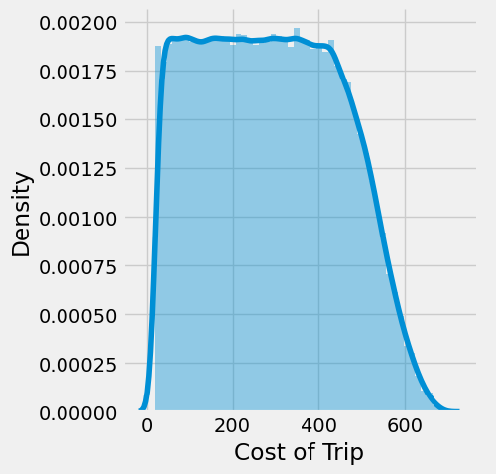
Univariate Distribution Plots

Slide 17
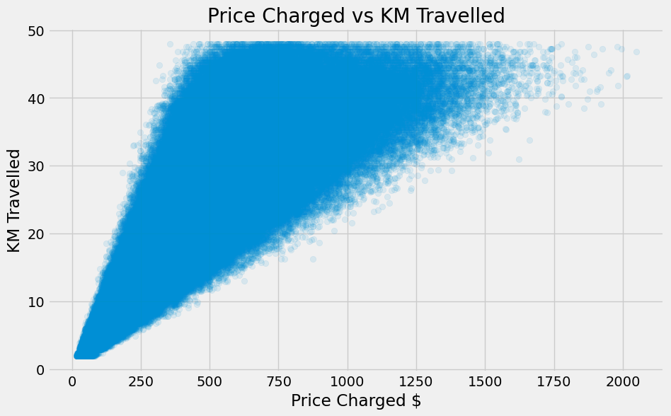
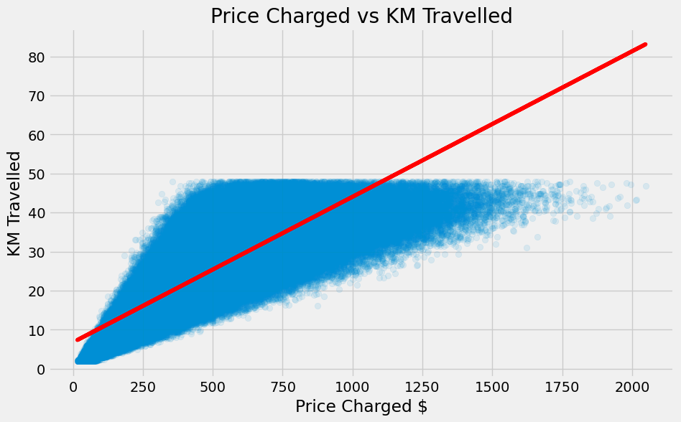
Linear Regression Models

Slide 18
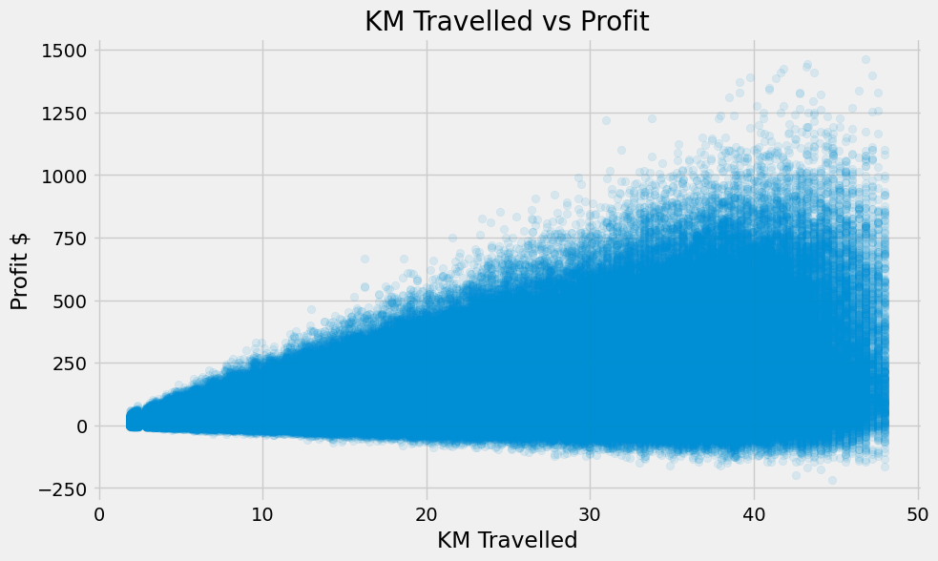

Linear Regression Models

Slide 19
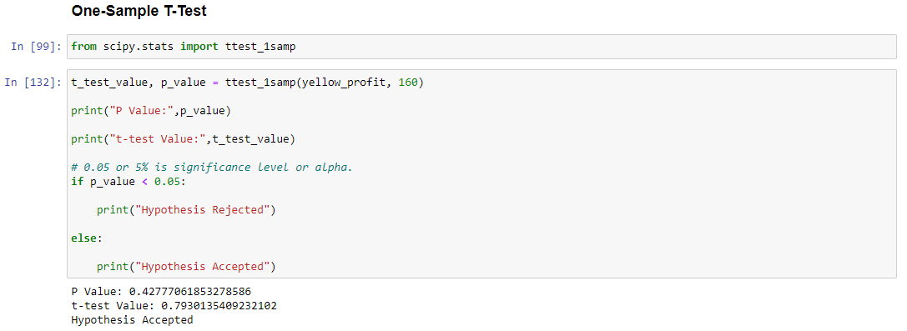
Parametric Hypothesis Tests

Slide 20
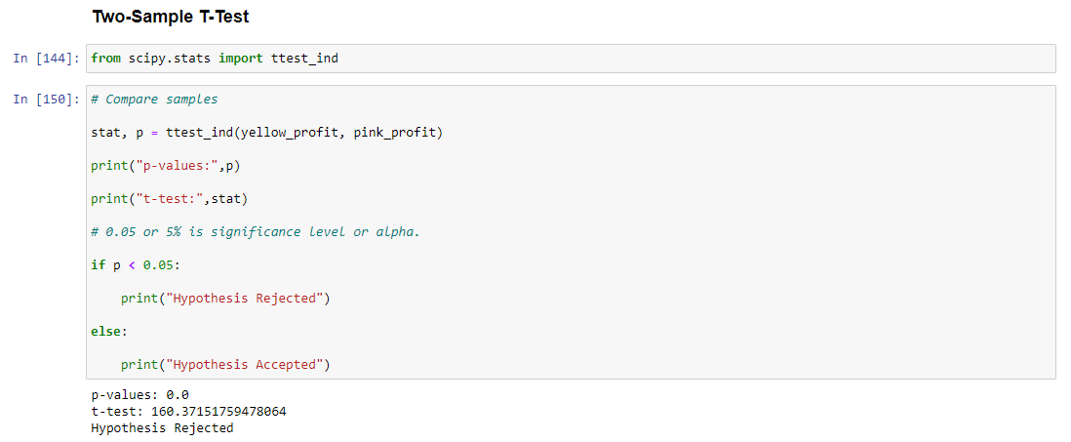
Parametric Hypothesis Tests

Slide 21
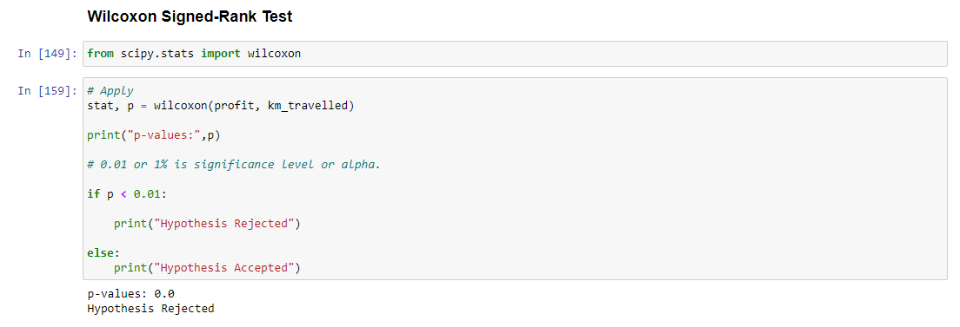
Non-Parametric Hypothesis Test

Slide 22
Recommendation
Insights
Through our Exploratory Data Analysis of the Yellow and Pink cab companies we have discovered several key insights.
New York City generates the most revenue across all cities for both companies
The difference between the price charged and cost of trip generates higher profit margins for Yellow Cab
Both companies show lateral rise and decline in profits between 2016 and 2018
NYC and Chicago customers have similar income ranges, yet profits are exponentially higher in NYC
The average age of customers across all cities is 35
Customers pay for their fare with card and cash similarly with a slight preference for card payments
Recommendations
Based on the Exploratory Analysis there is a strong recommendation for retail investors to choose Yellow Cab for long term returns.
However, we would recommend Pink Cab for industry investors as there is strong potential for growth and expansion, and with enhanced management the profit margins can be higher than yellow cab given there is a similar profit margin charged for the cost of ride vs price charged.

Slide 23
Thank You

